Slide 1
College Bazaar
Kelly Weber, James Moir, Patrick Isho, Trevor Drozd, Spenser Grzadzinski, Alissa Barnard

Slide 2
Sprint 3 (9/28-10/13)
GCP to go live
Placeholder page uploaded
DNS configuration for security platform
Integration of security and analytics tools
System security, data protection
Class or Entity Relationship Diagram
Website design
Database tables

Slide 3

Demo

Slide 4
Backend Developments
SQL database server created
SSH keys generated for secure access
More user accounts created and configured
Priority of work changed
Was SQL integration
Changed to publication
Live environment up next!

Slide 5
College Bazaar now public!
Static IP
DNS zone created with multiple entries
Name servers chosen with cloudbric
NS integration with domain registrar
Collegebazaar.shop and www.collegebazaar.shop now accessible

Slide 6
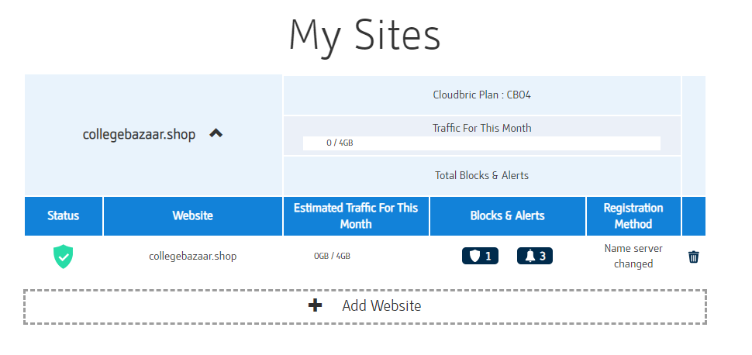
Security Developments

Slide 7
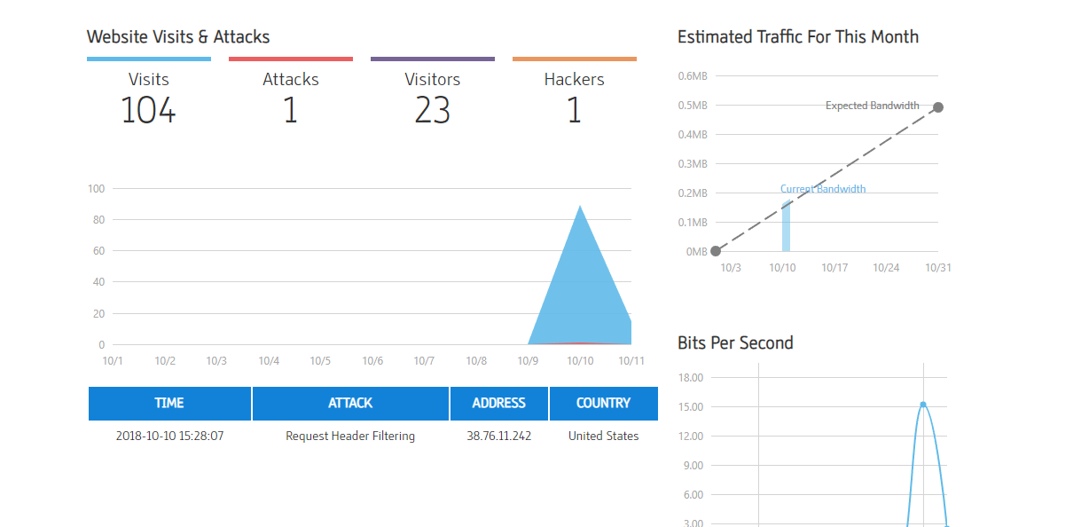
Security Developments

Slide 8
Conclusion
Development is still mostly along with our initial sprint plans
We’ve been successful in making improvements to the site look more professional and clean
Few hiccups with using Cloud9 as development environment, but nothing big
Still on track for our next sprint’s goals

